Slide 1
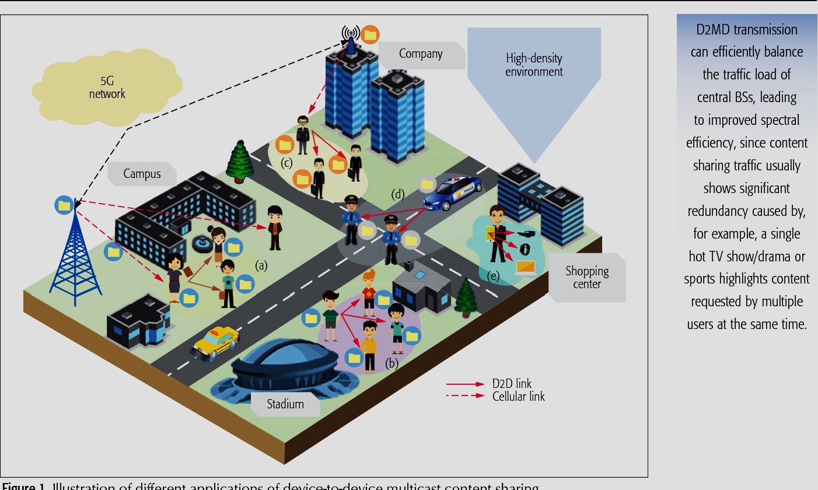
Data Networks Project (EC359)
Revenue Maximization in Multicast D2D Networks
Objective
Profit Maximization
&
Maximizing the number of Satisfied Users
Research Gap
Absence of appropriately priced varying data rates
Approach
Maximizing The Profit & Satisfied Users:
Greedy Heuristic
Team - Aalekh Prasad Patel Dharmesh Rajnish Kumar Saurabh Mani Tripathi Vinay Gupta

